Slide 1
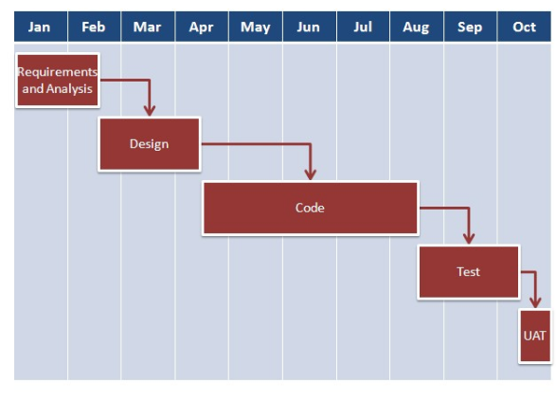
Agile Process Methodology
Traditional methodology
Notes:
http://istqbexamcertification.com/what-is-agile-methodology-examples-when-to-use-it-advantages-and-disadvantages/

Slide 2
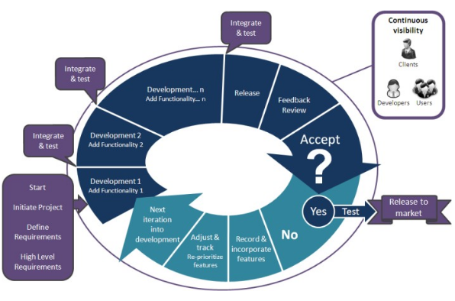

Slide 3
AGILE DEVELOPMENT PROCESS
Ther term “Agile” means ability to respond to changes, changes from requirement,technology and people.
Engineering actions creates cross Functional teams.
A team of oftware developers published the agile manifesto in 2001 highlighting the importance of the development team accomodating changing requirements and customer involvement.
MANIFESTO( a public declaration of policy and aims)

Slide 4
Manisfesto Includes:
Highest priority: customer satisfaction
welcome changing requirements
Deliver working software frequently
Simplicity
self organizing teams

Slide 5
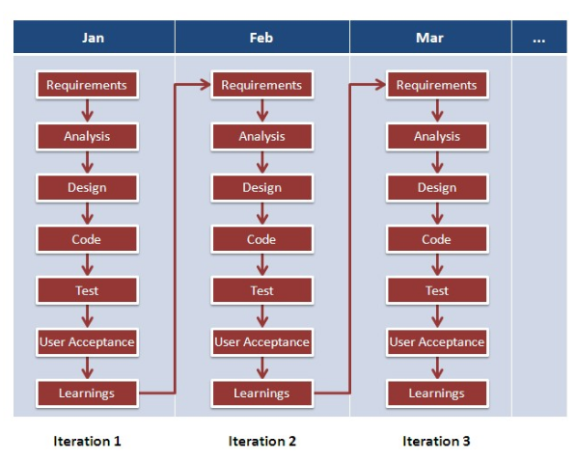

Slide 6
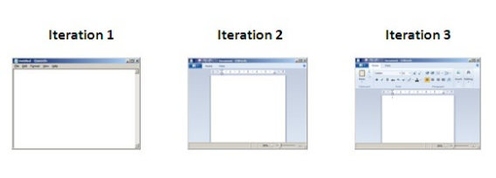

Slide 7
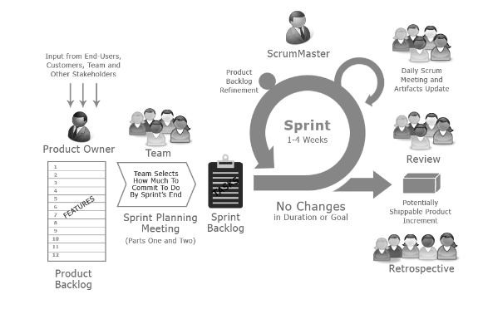
Scrum
Notes:
http://istqbexamcertification.com/what-are-agile-software-development-approaches-scrum-kanban-xp-explained/
http://www.softwaretestingandistqb.com/what-is-scrum-methodology-in-agile/

Slide 8
SCRUM OWNER
PRODUCT OWNER
this role has the vision of what they want to build.
a single person , he can have a team
he will be responsible to answer the question not his team

Slide 9
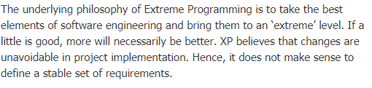
Extreme Programming
Notes:
When lot of requirements change.

Slide 10
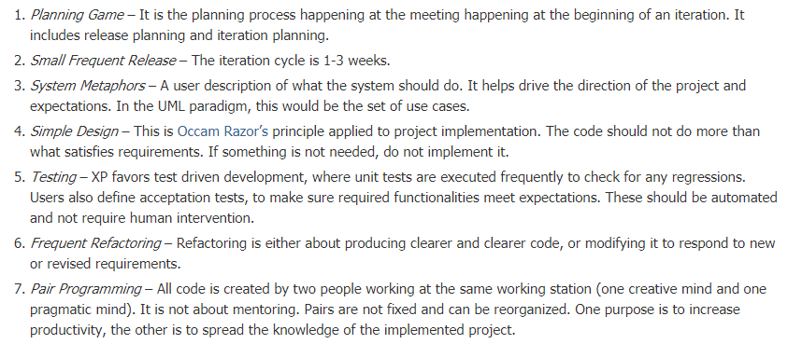
Core Practices

Slide 11
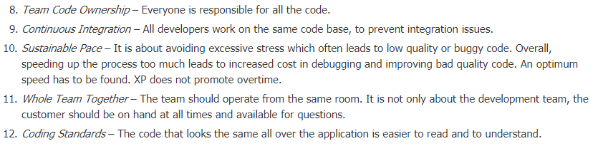

Slide 12
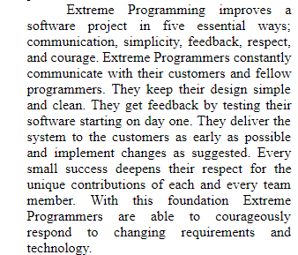
Extreme Programming

Slide 13
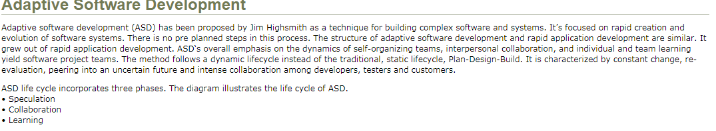
Notes:
Adaptive Software Development practices provide ability to accommodate change and are adaptable in turbulent environments with products evolving with little planning and learning.

Slide 14
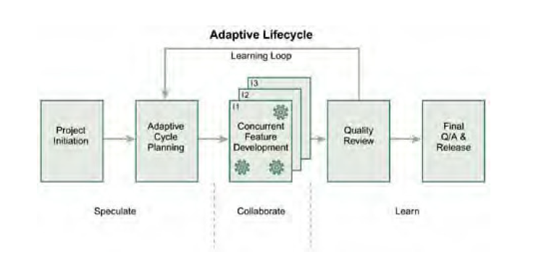
ASD Life cycle

Slide 15
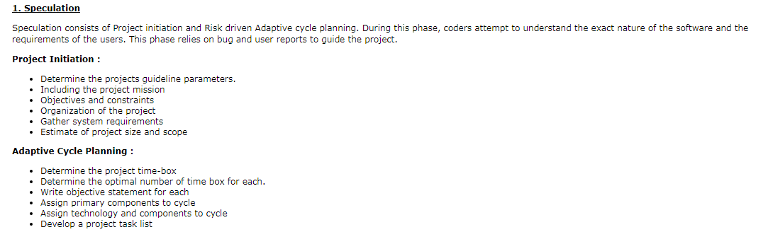

Slide 16
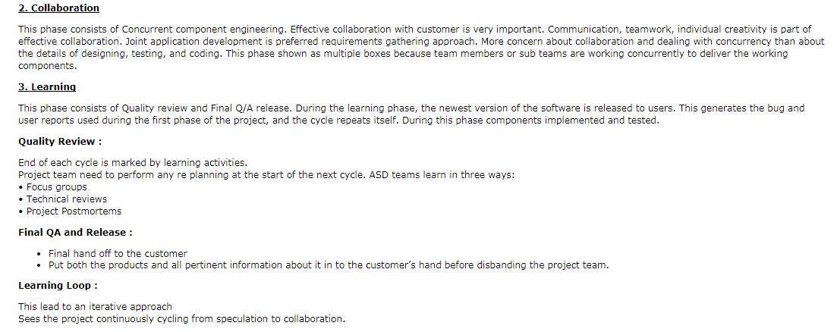

Slide 17
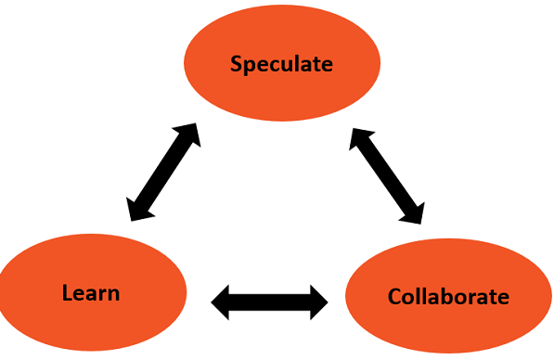

Slide 18
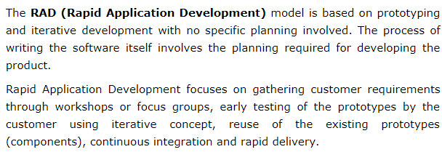
RAD
Notes:
Fast development
Sw reuse
Automated tool

Slide 19
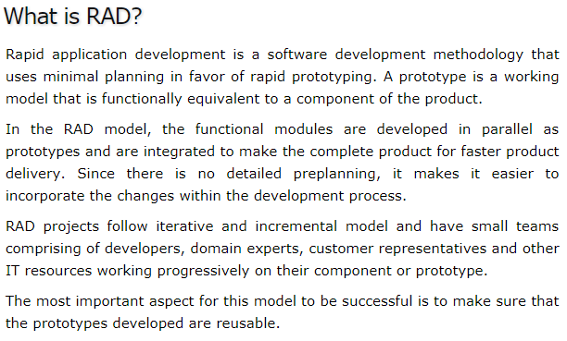

Slide 20
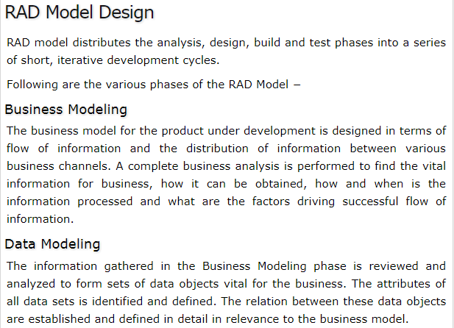

Slide 21
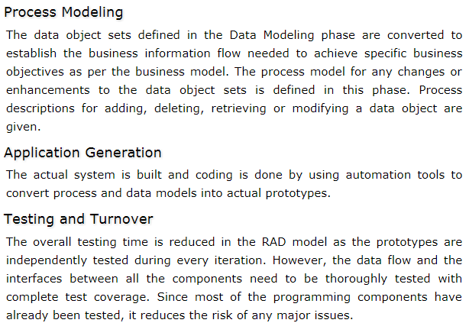

Slide 22
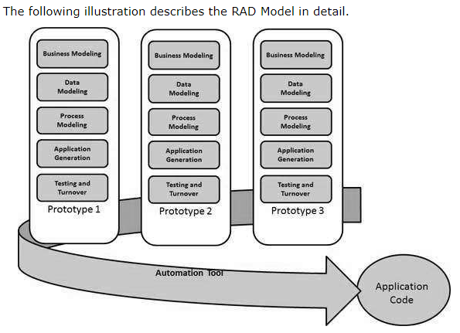

Slide 23
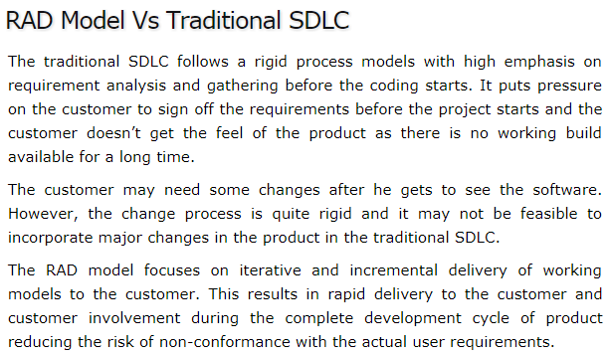

Slide 24
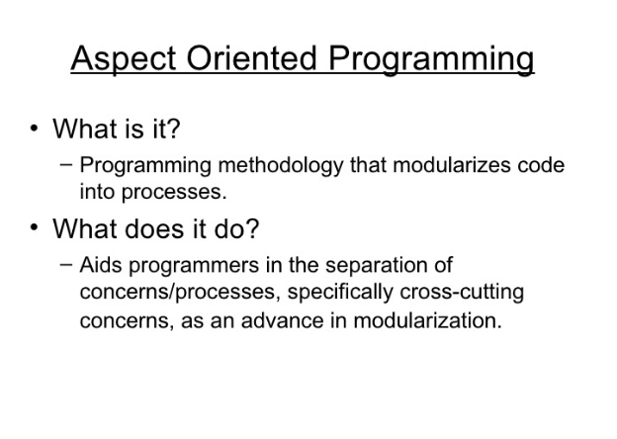

Slide 25
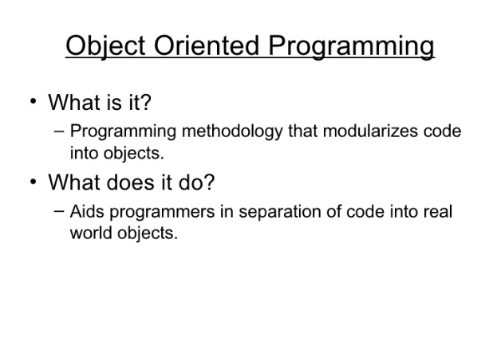

Slide 26
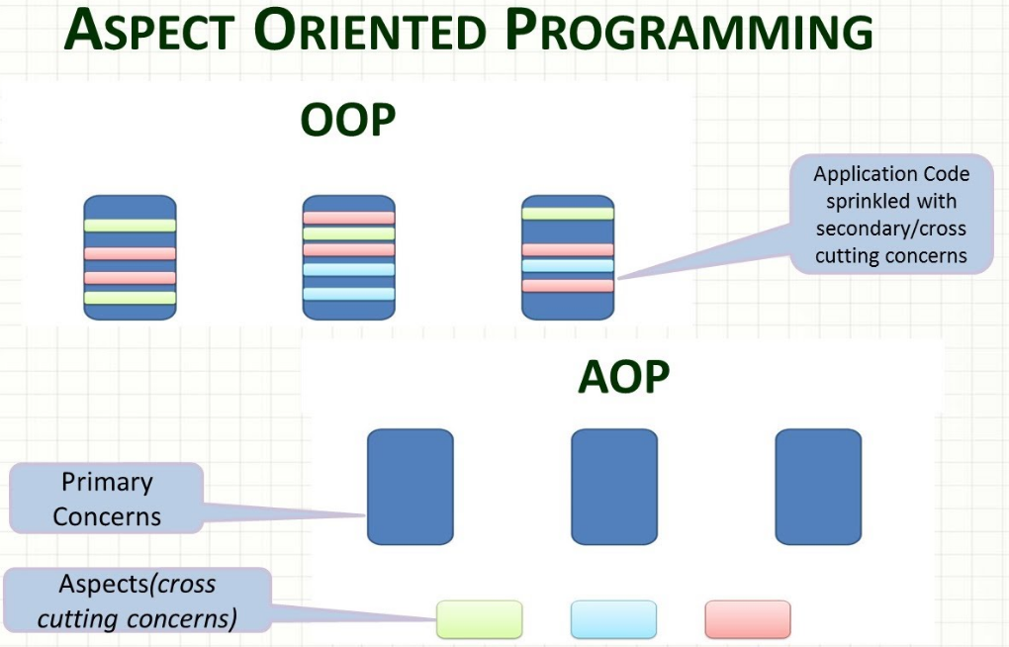

Slide 27
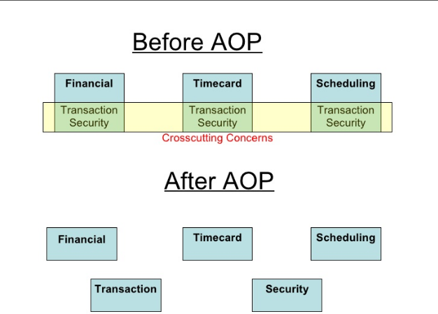

Slide 28
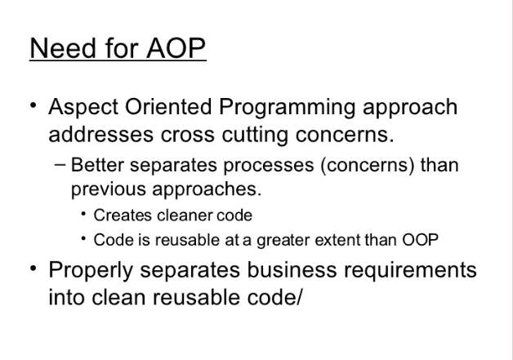

Slide 29
Software Cloning
Introduction
With the advancement of software industry, the IT sector is becoming more prone to the phenomenon of software piracy. Out of the various factors, one factor that results in software piracy is code clones that are becoming increasingly rampant causing harm to the IT world. For customers and IT company’s code clones cause a serious threat to the security and legitimate rights.
Therefore, it is very necessary to detect and check the various types of code clones

Slide 30
Code clones are the sections of very similar or identical code
that are obtained by reusing of code fragments by copying and
pasting with or without any major or minor adaptations . Due
to the reason of copy- and- paste programming code clones have
resulted in generating various issues as listed below:
• Degrades reusability and maintainability of code.
• Long repeated sections of code are created which differ in
only a few lines or characters.
• Specific purpose of each section remains hidden.
• Redundancy of code increases which has to be avoided.
• Increases the maintenance costs.

Slide 31
